Slide 1
Performance Evaluation of Container Runtimes on EKS, GKE & Manual K8S Deployment
Rachit Jain (rj2219)
Siddhartha Singh (ss13793)
Shivanshi (ss14396)

Slide 2
Introduction
Cloud computing has reached a point where it has become necessary to build applications in the cloud.
An easier way of using this is because of containerization which is the concept of bundling up the application with its dependencies.
Containerization has the advantage over a VM by being lightweight.
With the increase of containers, it is important to use orchestration tools.
Kubernetes, developed by Google, has become the de facto standard of orchestration.

Slide 3
Literature Survey
Espe et al¹:
Comparison of performance of high level containers such as containerd and CRIO.
Viktorsson et al²:
Comparing low level containers runtimes based on their security and performance.
Comparison between gVisor, Kata, and runC.
Our novelty:
Comparison of different high level container runtimes - containerd and docker.
Deploying a baseline K8S cluster using Terraform on AWS.
Performance Evaluation of Container Runtimes
Security-Performance Trade-offs of Kubernetes Container Runtimes

Slide 4
Evaluation Methodology
Problem Identification
05
Final Conclusions
01
04
Experimental Design and Analysis
Metrics and Benchmarks Listing
(Disk, Memory, CPU, Network)
02
03
System Configuration Selection

Slide 5
Sysbench Benchmark
It is an open source benchmark for CPU load and Disk I/O.
For CPU load, we calculated the prime numbers till 30000 using 2 threads.
We captured the events per second. (Events / second)
For Disk I/O, we performed disk intensive operations such as random reads and writes.
Bypassed caching mechanism performed by the RAM.
We captured the read and write operations with a file size of 9GB. (MB / second)

Slide 6
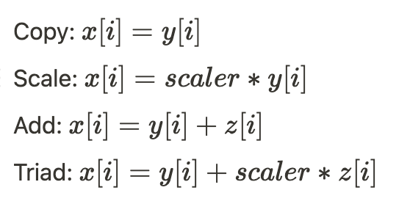
STREAM Benchmark
Measures memory performance by performing 4 operations: Copy, Add, Scale, Triad.
Important to know how quickly data can be read from or written to memory.
Measuring data throughput capacity from the main memory. (MB / second)
Number of elements = N = 10000000

Slide 7
Netperf Benchmark
This tool is used for benchmarking communication latencies with the TCP stack.
The benchmarks follows the client server architecture.
Netperf client and server deployed on pods on the same worker node:
One node is chosen as both the client and server.
Netperf client and server deployed on pods on a different worker node:
One node is chosen as the client and and another one as the server.
There is transmission of only one packet at any given time.
We capture the TCP round trip network latency. (MBPS)

Slide 8
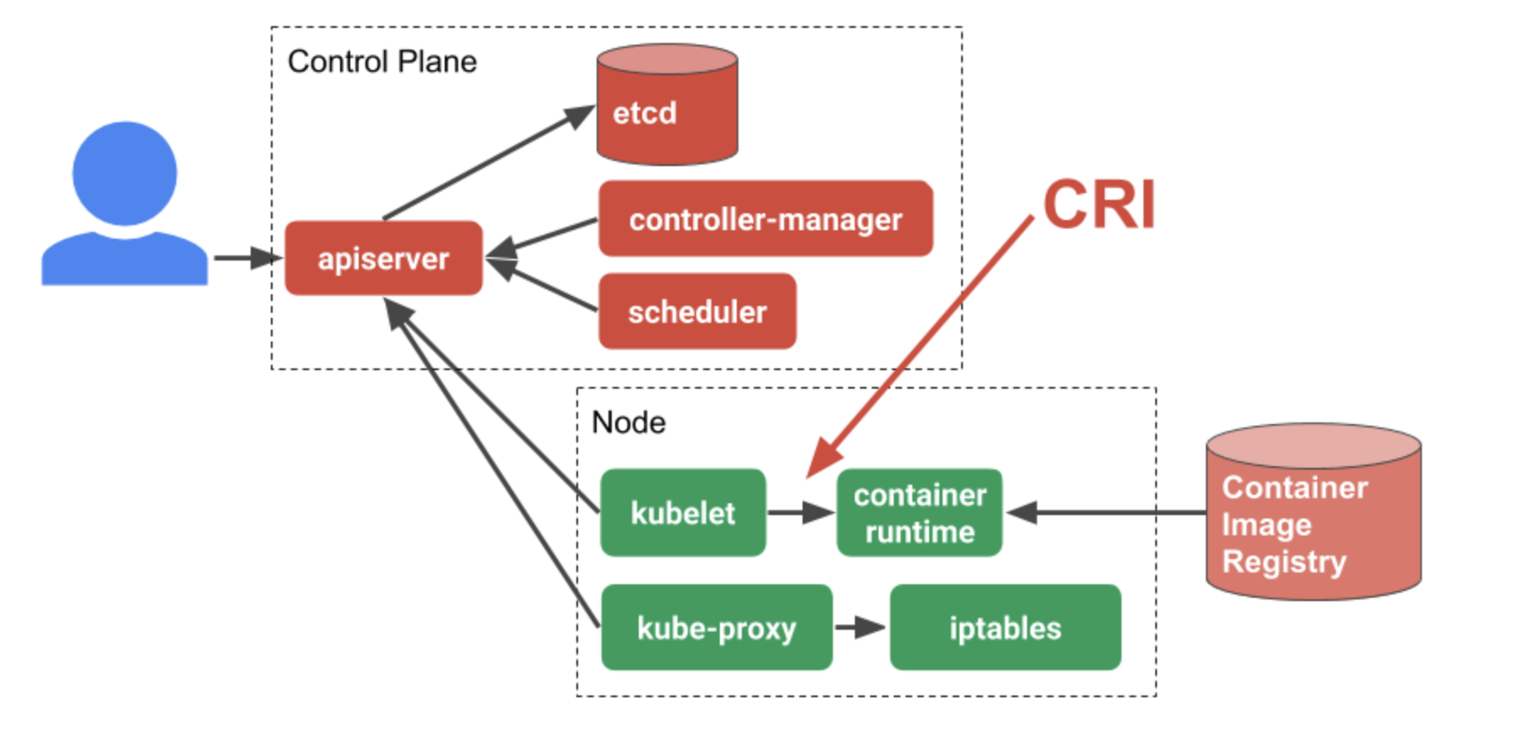
Who is running the containers?
Kubernetes is an orchestrator
Kubernetes doesn’t run your containers
Kubelet talks to container runtime to create/manage containers

Slide 9
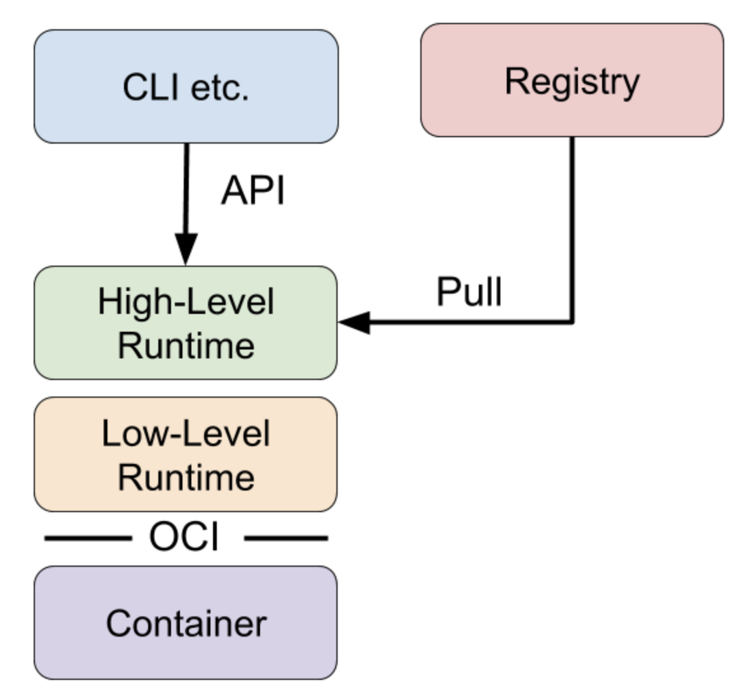
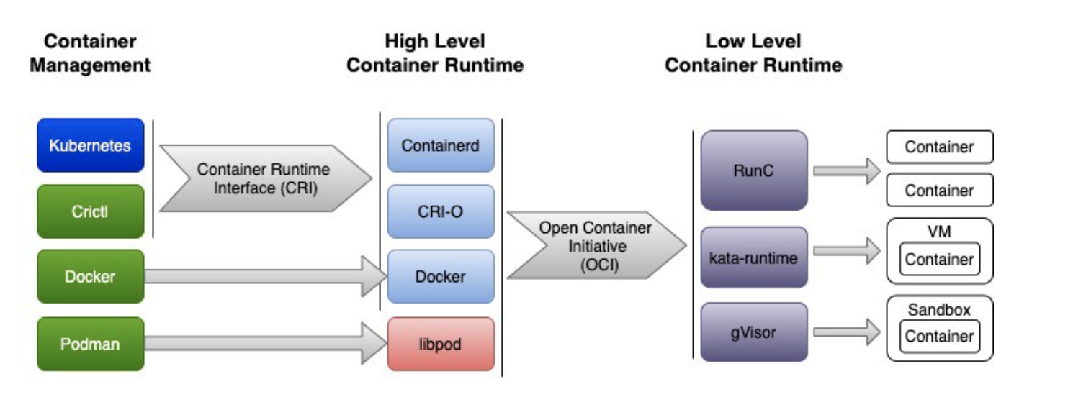
Container Runtime System
Docker released OCI specification with its modularized docker engine 1.11 in association with Linux foundation.
OCI provides specifications for container images and how to run containers. It also provides reference implementation of runtime spec called RunC which was donated by Docker.
Container runtime is divided into two parts as High Level Container Runtime (Container engine) and Low Level Container Runtime (OCI Runtime).

Slide 10
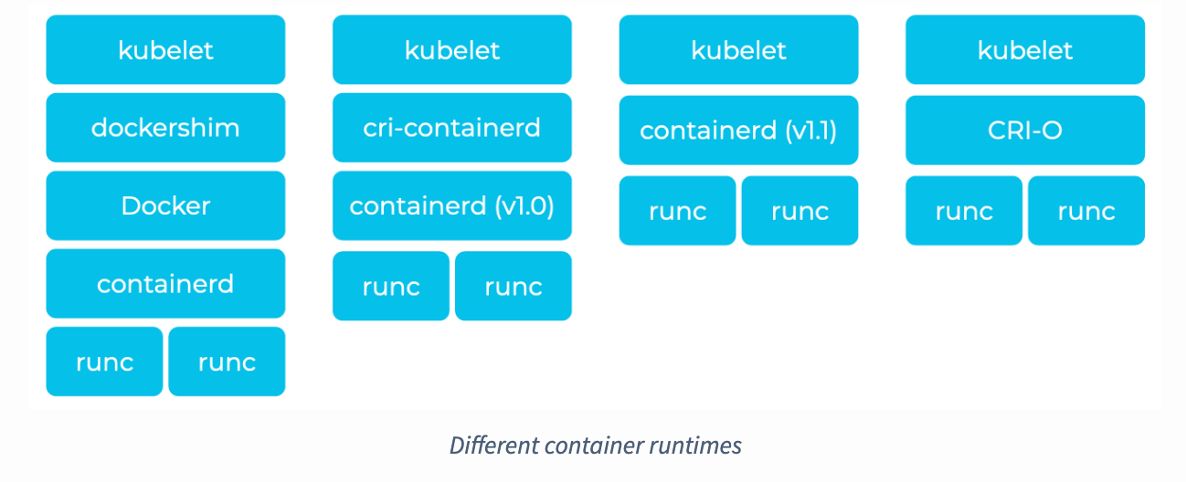
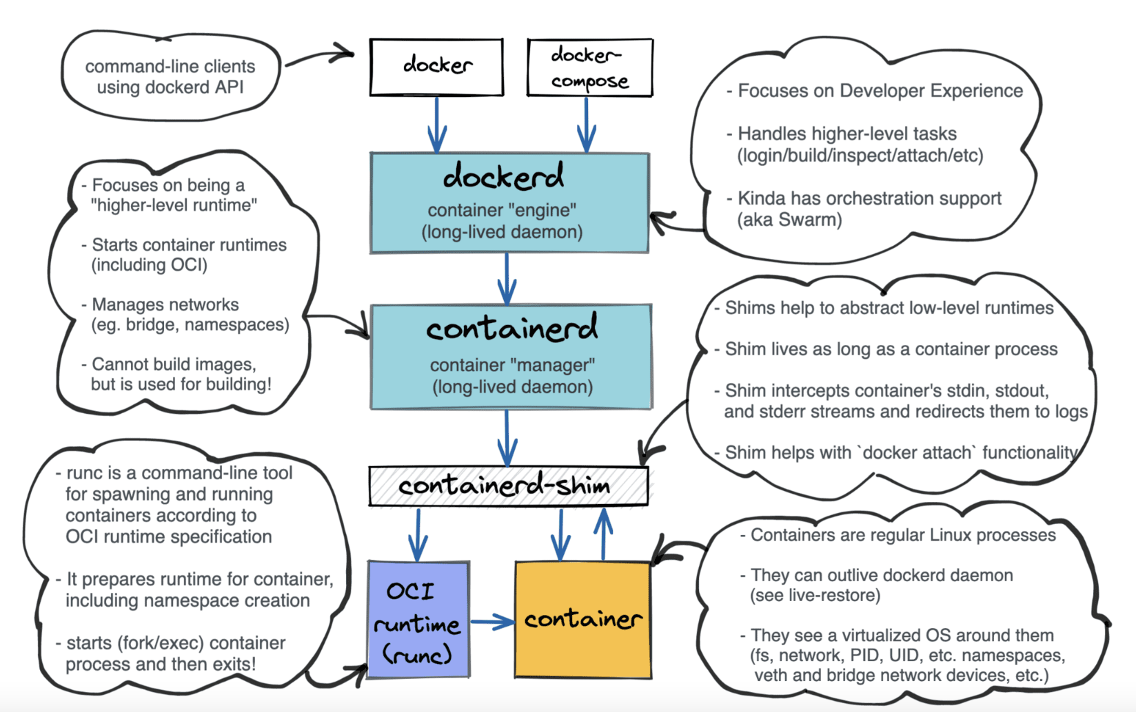
Container Runtime Interface
In the Kubernetes 1.5 release, the Container Runtime Interface (CRI) was introduced. It is a plugin interface which enables kubelet to use a wide variety of container runtimes, without the need to recompile.
Docker is not actually a container runtime but instead it is a collection of tools that sits on top of a container runtime called containerd.

Slide 11
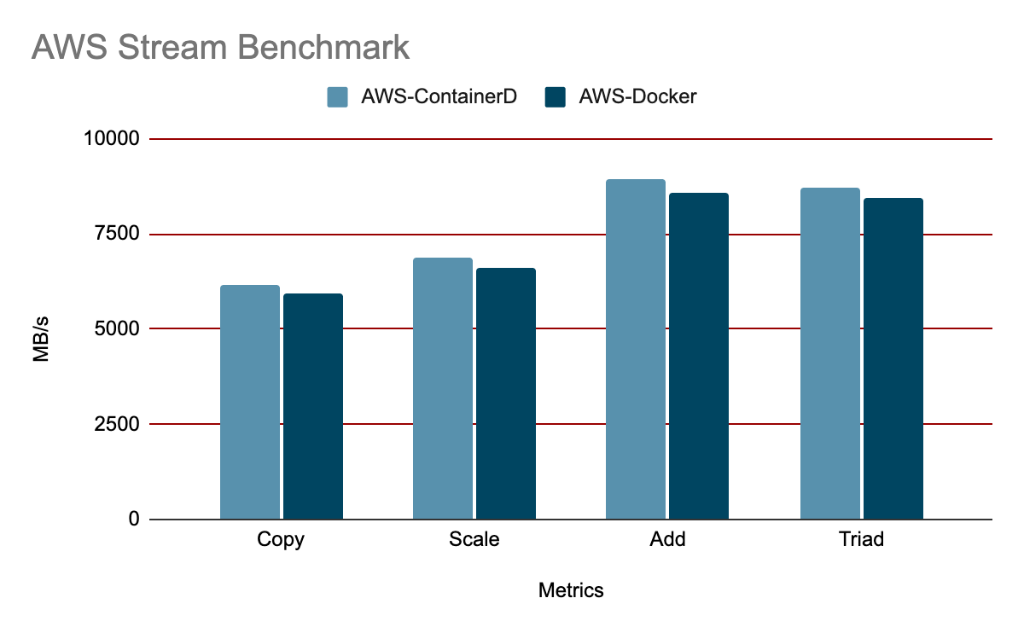
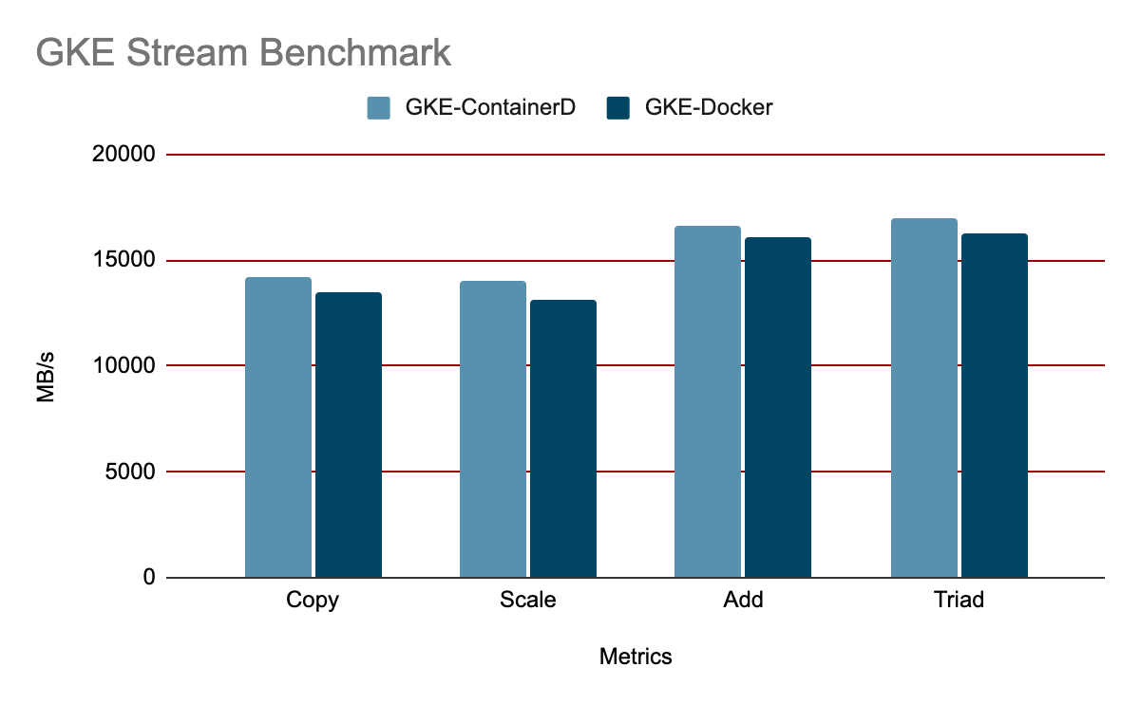
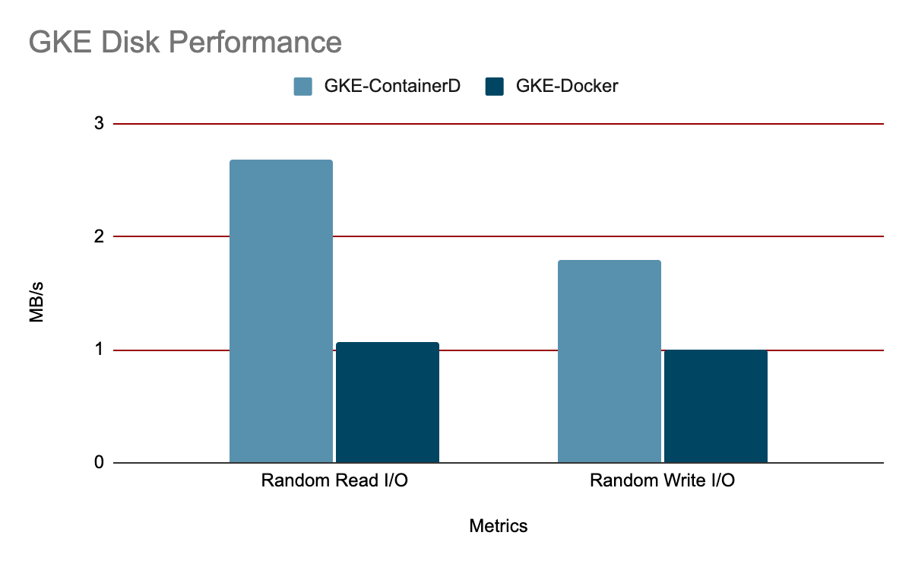
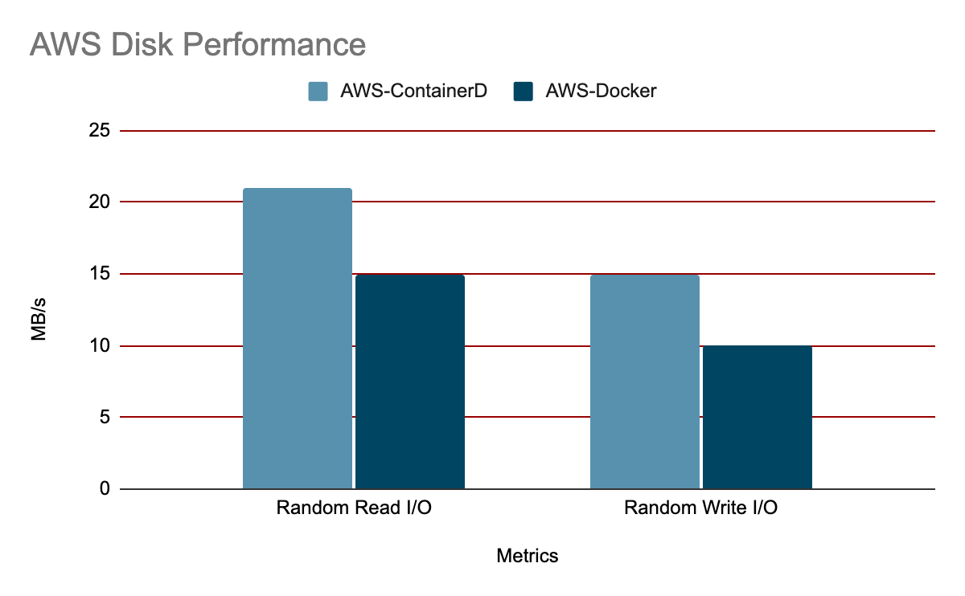
Time for some Results

Slide 12
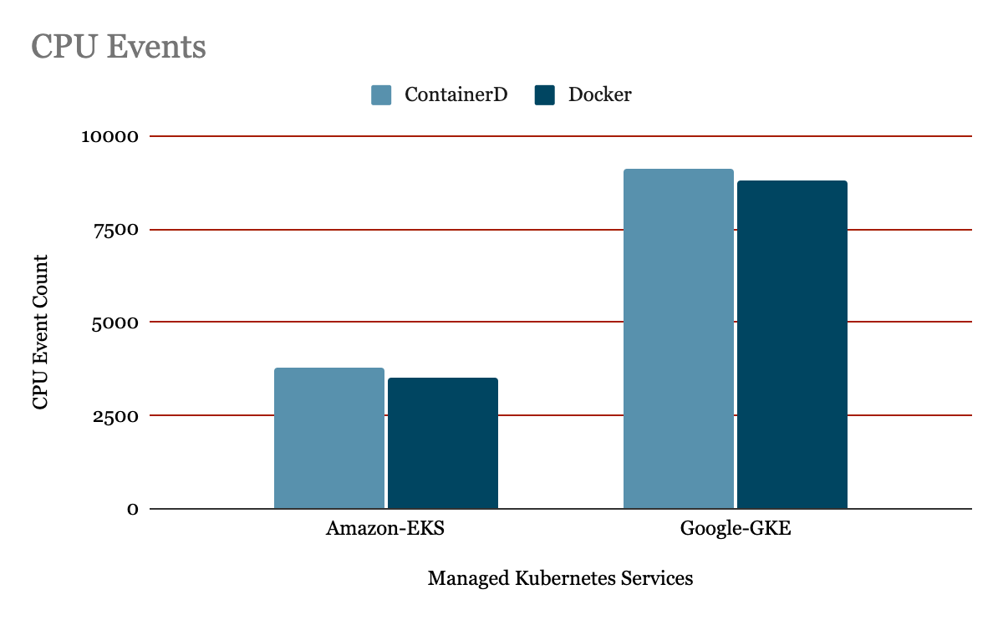
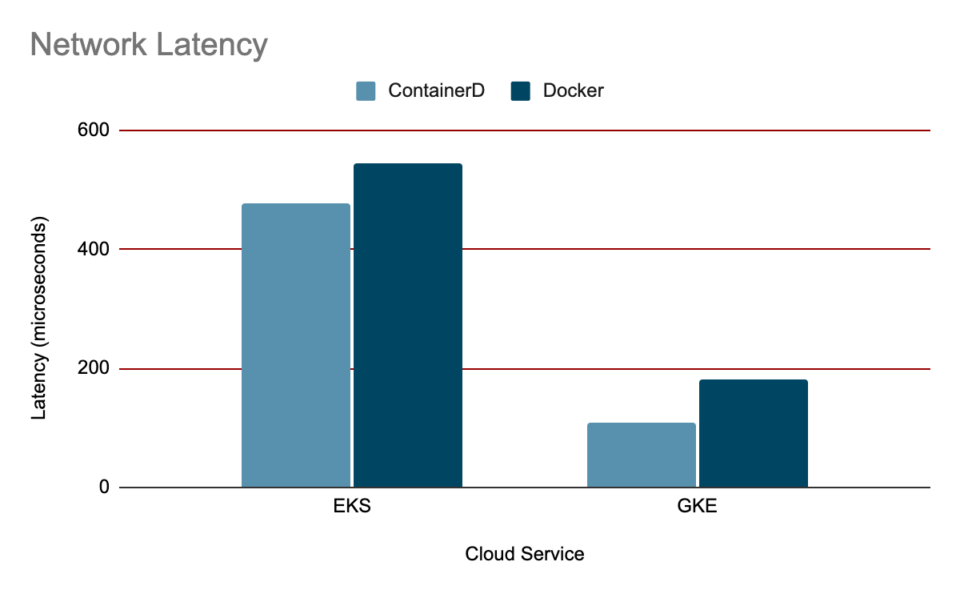
And some more…

Slide 13
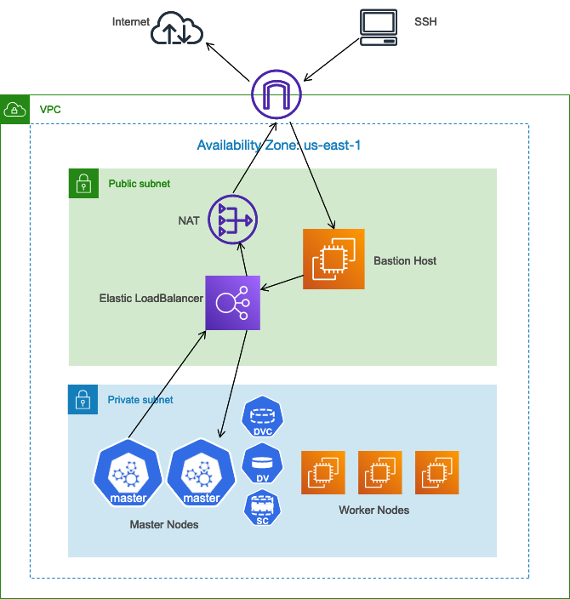
Baseline K8S Architecture
Public Subnet to host the NAT gateway, Bastion Host, and ELB
Private Subnet to host the Master and Worker Nodes
Internet Gateway to enable communication with the internet and SSH
Virtual Private Cloud (spanned over a single region)
Security Groups, Route Tables, Key pair, Auto-Scaling groups, and IAM Roles constructed as well
Kubeadm to bootstrap the master and worker nodes and deploy the control plane

Slide 14
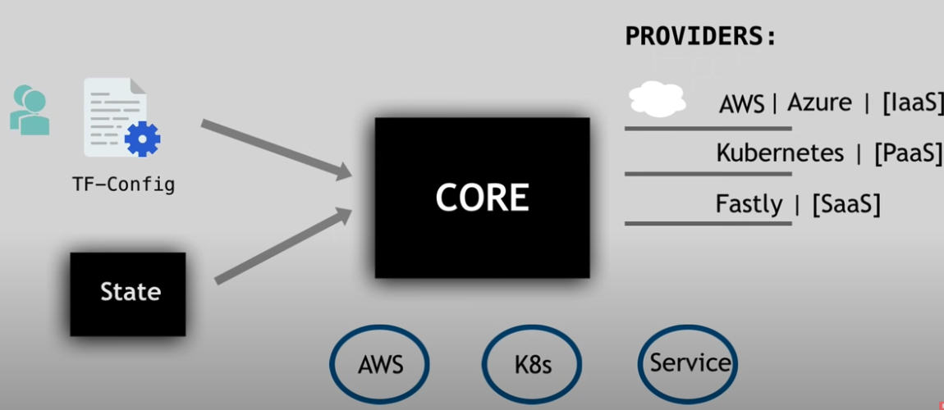
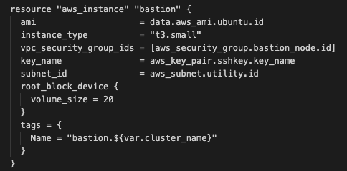
Terraform
Automates, and manages infra, platform and services that run on platform
Open Source, and Declarative (i.e define WHAT end result we want)
Has over 100 providers spanning over different technologies. Each provider gives TF access to resources
CORE creates an execution plan taking into account the Config and current state of infra

Slide 15
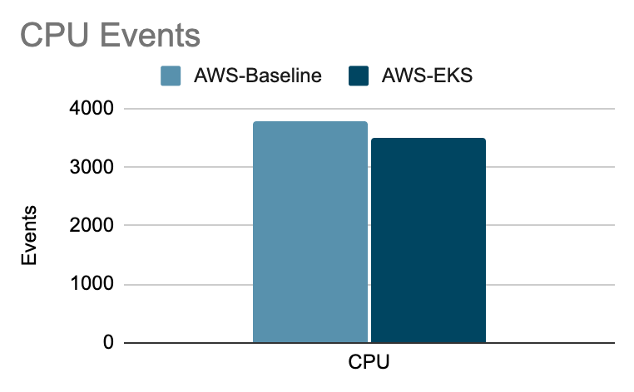
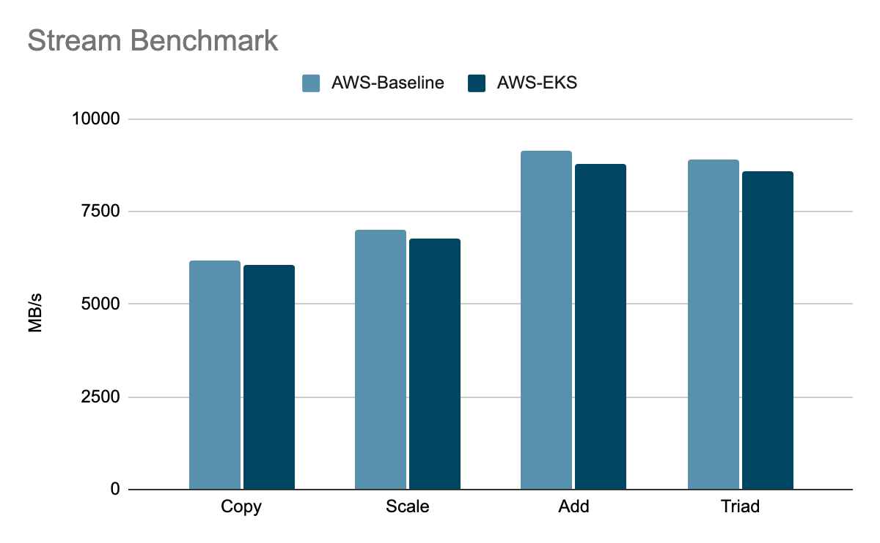
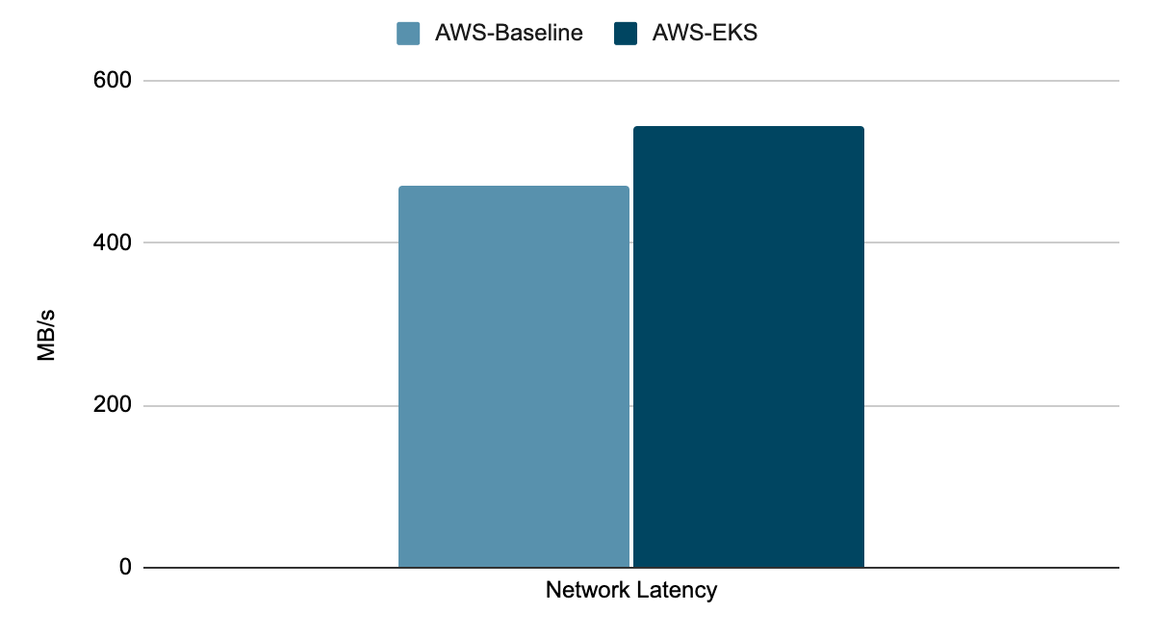
Results

Slide 16
Conclusions and our thoughts
Managed K8S providers are not flexible on the choice of lower level runtimes
ContainerD comes out to be a clear winner as the choice for the higher level runtime
Cloud providers are ending support for Docker
There is significant overhead in creating your own cluster and Managed services are easier to set up
We would have deployed etcd, scheduler as separate nodes and were surprised to see that Managed services don’t do that
Finally, Deploy workloads on our cluster at your own risk.

Slide 17
References
[1] https://kubernetes.io/docs/home/
[2] https://www.scitepress.org/Papers/2020/93404/93404.pdf
[3] https://aws.amazon.com/eks/features/
[4] https://cloud.google.com/kubernetes-engine#section-2
[5] https://containerd.io/
[6] https://www.aquasec.com/cloud-native-academy/container-security/container-runtime/
[7]https://www.ianlewis.org/en/container-runtimes-part-3-high-level-runtimes#:~:text=While%20low%2Dlevel%20runtimes%20are,runtime%20to%20run%20the%20container

